Slide 1
Hypothesis Testing In class Quiz-23/4/2017
Problem Statement:
A retailer is weighing strawberries to sell as 250g punnets. A customer has complained that strawberries he had bought previously weighed under 250g. The retailer decides to check the weight of 36 punnets. He finds that the average weight is 248.5g. with standard deviation 4.8g. In using a significance test to judge whether he is selling under-weight punnets, which of the following conclusions is correct?
a. At 5% level he is selling under weight
b. At 5% level he is not selling under weight
c. At 5% level the test is inconclusive
d. A significance test is inappropriate in this case

Slide 2
Solution: Formulation of Null and Alternative Hypotheses
μ = Population Mean
H₀: μ > =250
H₁: μ < 250

Slide 3
Test Statistics
Under the null hypothesis being true,
the Computed

Slide 4
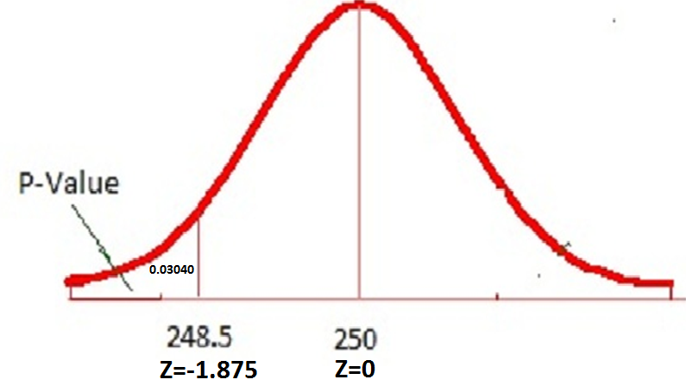
Picture Giving P-Value
Calculated Z= - 1.875 . P-Value =P(Z<-1.875)= 0.03040(4 decimals)
P-Value less than alpha of 0.05. The null hypothesis is rejected.
Choice a) is correct. At 5% level he is selling under weight

